Slide 1
dropdowns
Taught by Yossef Ayman Zedan

Slide 2
Single button
Any single .btn can be turned into a dropdown toggle with some markup changes. Here’s how you can put them to work with either <button> elements:
<div class="dropdown">
<button class="btn btn-secondary dropdown-toggle" type="button" id="dropdownMenuButton1" data-bs-toggle="dropdown">
Dropdown button
</button>
<ul class="dropdown-menu" aria-labelledby="dropdownMenuButton1">
<li><a class="dropdown-item" href="#">Action</a></li>
<li><a class="dropdown-item" href="#">Another action</a></li>
<li><a class="dropdown-item" href="#">Something else here</a></li>
</ul>
</div>

Slide 3
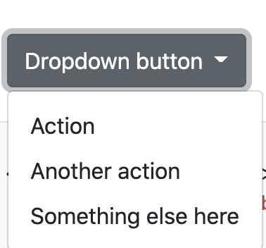
Single button
Any single .btn can be turned into a dropdown toggle with some markup changes. Here’s how you can put them to work with either <button> elements:
<div class="dropdown">
<button class="btn btn-secondary dropdown-toggle" type="button" id="dropdownMenuButton1" data-bs-toggle="dropdown">
Dropdown button
</button>
<ul class="dropdown-menu" aria-labelledby="dropdownMenuButton1">
<li><a class="dropdown-item" href="#">Action</a></li>
<li><a class="dropdown-item" href="#">Another action</a></li>
<li><a class="dropdown-item" href="#">Something else here</a></li>
</ul>
</div>

Slide 4
Single button
And with <a> elements:
<div class="dropdown">
<a class="btn btn-secondary dropdown-toggle" href="#" role="button" id="dropdownMenuLink" data-bs-toggle="dropdown">
Dropdown link
</a>
<ul class="dropdown-menu" aria-labelledby="dropdownMenuLink">
<li><a class="dropdown-item" href="#">Action</a></li>
<li><a class="dropdown-item" href="#">Another action</a></li>
<li><a class="dropdown-item" href="#">Something else here</a></li>
</ul>
</div>

Slide 5
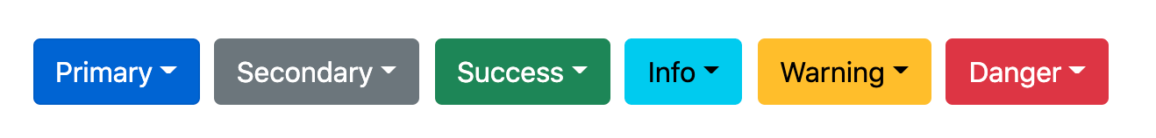
Single button
The best part is you can do this with any button variant, too:
<button type="button" class="btn btn-danger dropdown-toggle" data-bs-toggle="dropdown"> </button>

Slide 6
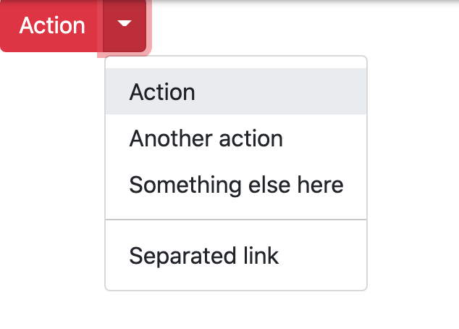
Split button
Similarly, create split button dropdowns with virtually the same markup as single button dropdowns, but with the addition of .dropdown-toggle-split for proper spacing around the dropdown caret.
Bootstrap uses this extra class to reduce the horizontal padding on either side of the caret by 25% and remove the margin-left that’s added for regular button dropdowns. Those extra changes keep the caret centered in the split button and provide a more appropriately sized hit area next to the main button.

Slide 7
Split button
<!-- Example split danger button -->
<div class="btn-group">
<button type="button" class="btn btn-danger">Action</button>
<button type="button" class="btn btn-danger dropdown-toggle dropdown-toggle-split">
</button>
<ul class="dropdown-menu">
<li><a class="dropdown-item" href="#">Action</a></li>
<li><a class="dropdown-item" href="#">Another action</a></li>
<li><a class="dropdown-item" href="#">Something else here</a></li>
<li><hr class="dropdown-divider"></li>
<li><a class="dropdown-item" href="#">Separated link</a></li>
</ul>
</div>

Slide 8
Sizing
Large button:
<div class="btn-group">
<button class="btn btn-secondary btn-lg dropdown-toggle" type="button" data-bs-toggle="dropdown" aria-expanded="false">
Large button
</button>
<ul class="dropdown-menu">
...
</ul>
</div>

Slide 9
Sizing
Large split button:
<div class="btn-group">
<button class="btn btn-secondary btn-lg" type="button">
Large split button
</button>
<button type="button" class="btn btn-lg btn-secondary dropdown-toggle dropdown-toggle-split" data-bs-toggle="dropdown" aria-expanded="false">
<span class="visually-hidden">Toggle Dropdown</span>
</button>
<ul class="dropdown-menu">
...
</ul>
</div>

Slide 10
Sizing
Small button:
<div class="btn-group">
<button class="btn btn-secondary btn-sm dropdown-toggle" type="button" data-bs-toggle="dropdown" aria-expanded="false">
Small button
</button>
<ul class="dropdown-menu">
...
</ul>
</div>

Slide 11
Sizing
Small split button:
<div class="btn-group">
<button class="btn btn-secondary btn-sm" type="button">
Small split button
</button>
<button type="button" class="btn btn-sm btn-secondary dropdown-toggle dropdown-toggle-split" data-bs-toggle="dropdown" aria-expanded="false">
<span class="visually-hidden">Toggle Dropdown</span>
</button>
<ul class="dropdown-menu">
...
</ul>
</div>

Slide 12
Dark dropdowns
Opt into darker dropdowns to match a dark navbar or custom style by adding .dropdown-menu-dark onto an existing .dropdown-menu. No changes are required to the dropdown items.
<div class="dropdown">
<button class="btn btn-secondary dropdown-toggle" type="button" id="dropdownMenuButton2" data-bs-toggle="dropdown">
Dropdown button
</button>
<ul class="dropdown-menu dropdown-menu-dark" aria-labelledby="dropdownMenuButton2">
<li><a class="dropdown-item active" href="#">Action</a></li>
<li><a class="dropdown-item" href="#">Another action</a></li>
<li><a class="dropdown-item" href="#">Something else here</a></li>
<li><hr class="dropdown-divider"></li>
<li><a class="dropdown-item" href="#">Separated link</a></li>
</ul>
</div>

Slide 13
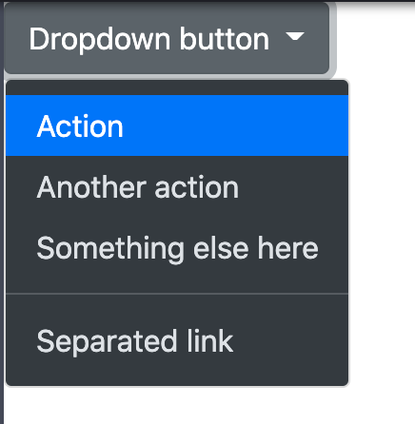
Dark dropdowns

Slide 14
Directions
<!-- Default dropup button -->
<div class="btn-group dropup">
<button type="button" class="btn btn-secondary dropdown-toggle" data-bs-toggle="dropdown" aria-expanded="false">
Dropup
</button>
<ul class="dropdown-menu">
<!-- Dropdown menu links -->
</ul>
</div>

Slide 15
Directions
<!-- Split dropup button -->
<div class="btn-group dropup">
<button type="button" class="btn btn-secondary">
Split dropup
</button>
<button type="button" class="btn btn-secondary dropdown-toggle dropdown-toggle-split" data-bs-toggle="dropdown" aria-expanded="false">
<span class="visually-hidden">Toggle Dropdown</span>
</button>
<ul class="dropdown-menu">
<!-- Dropdown menu links -->
</ul>
</div>

Slide 16
Directions
dropstart for left, end for right,

Slide 17
Menu items
You can use <a> or <button> elements as dropdown items.
<div class="dropdown">
<button class="btn btn-secondary dropdown-toggle" type="button" id="dropdownMenu2" data-bs-toggle="dropdown">
Dropdown
</button>
<ul class="dropdown-menu" aria-labelledby="dropdownMenu2">
<li><button class="dropdown-item" type="button">Action</button></li>
<li><button class="dropdown-item" type="button">Another action</button></li>
<li><button class="dropdown-item" type="button">Something else here</button></li>
</ul>
</div>

Slide 18
Menu items
You can also create non-interactive dropdown items with .dropdown-item-text. Feel free to style further with custom CSS or text utilities.
<ul class="dropdown-menu">
<li><span class="dropdown-item-text">Dropdown item text</span></li>
<li><a class="dropdown-item" href="#">Action</a></li>
<li><a class="dropdown-item" href="#">Another action</a></li>
<li><a class="dropdown-item" href="#">Something else here</a></li>
</ul>

Slide 19
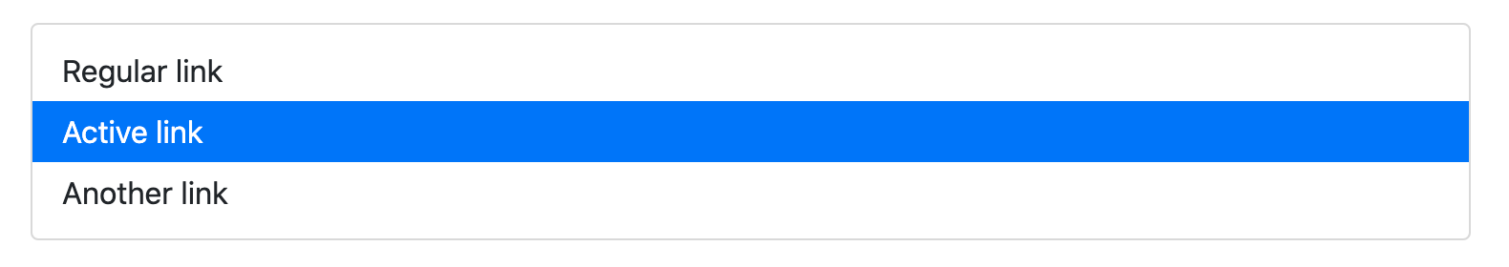
Active
Add .active to items in the dropdown to style them as active.
<ul class="dropdown-menu">
<li><a class="dropdown-item" href="#">Regular link</a></li>
<li><a class="dropdown-item active" href="#">Active link</a></li>
<li><a class="dropdown-item" href="#">Another link</a></li>
</ul>

Slide 20
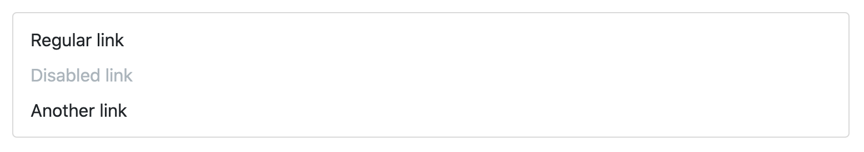
Disabled
Add .disabled to items in the dropdown to style them as disabled.
<ul class="dropdown-menu">
<li><a class="dropdown-item" href="#">Regular link</a></li>
<li><a class="dropdown-item disabled" href="#">Disabled link</a></li>
<li><a class="dropdown-item" href="#">Another link</a></li>
</ul>

Slide 21
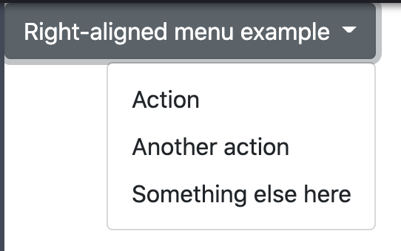
Menu alignment
By default, a dropdown menu is automatically positioned 100% from the top and along the left side of its parent. You can change this with the directional .drop* classes, but you can also control them with additional modifier classes.
Add .dropdown-menu-end to a .dropdown-menu to right align the dropdown menu. Directions are mirrored when using Bootstrap in RTL, meaning .dropdown-menu-end will appear on the left side.

Slide 22
Menu alignment
<div class="btn-group">
<button type="button" class="btn btn-secondary dropdown-toggle" data-bs-toggle="dropdown" aria-expanded="false">
Right-aligned menu example
</button>
<ul class="dropdown-menu dropdown-menu-end">
<li><button class="dropdown-item" type="button">Action</button></li>
<li><button class="dropdown-item" type="button">Another action</button></li>
<li><button class="dropdown-item" type="button">Something else here</button></li>
</ul>
</div>

Slide 23
Responsive Menu alignment
If you want to use responsive alignment, disable dynamic positioning by adding the data-bs-display="static" attribute and use the responsive variation classes.
To align right the dropdown menu with the given breakpoint or larger, add .dropdown-menu{-sm|-md|-lg|-xl|-xxl}-end.
Left-aligned but right aligned when large screen

Slide 24
Responsive Menu alignment
Left-aligned but right aligned when large screen
<div class="btn-group">
<button type="button" class="btn btn-secondary dropdown-toggle" data-bs-toggle="dropdown" data-bs-display="static" aria-expanded="false">
Left-aligned but right aligned when large screen
</button>
<ul class="dropdown-menu dropdown-menu-lg-end">
<li><button class="dropdown-item" type="button">Action</button></li>
<li><button class="dropdown-item" type="button">Another action</button></li>
<li><button class="dropdown-item" type="button">Something else here</button></li>
</ul>
</div>

Slide 25
Responsive Menu alignment
Right-aligned but left aligned when large screen
<div class="btn-group">
<button type="button" class="btn btn-secondary dropdown-toggle" data-bs-toggle="dropdown" data-bs-display="static" aria-expanded="false">
Right-aligned but left aligned when large screen
</button>
<ul class="dropdown-menu dropdown-menu-end dropdown-menu-lg-start">
<li><button class="dropdown-item" type="button">Action</button></li>
<li><button class="dropdown-item" type="button">Another action</button></li>
<li><button class="dropdown-item" type="button">Something else here</button></li>
</ul>
</div>

Slide 26
Responsive Menu alignment
Right-aligned but left aligned when large screen
<div class="btn-group">
<button type="button" class="btn btn-secondary dropdown-toggle" data-bs-toggle="dropdown" data-bs-display="static" aria-expanded="false">
Right-aligned but left aligned when large screen
</button>
<ul class="dropdown-menu dropdown-menu-end dropdown-menu-lg-start">
<li><button class="dropdown-item" type="button">Action</button></li>
<li><button class="dropdown-item" type="button">Another action</button></li>
<li><button class="dropdown-item" type="button">Something else here</button></li>
</ul>
</div>

Slide 27
Headers
<ul class="dropdown-menu">
<li><h6 class="dropdown-header">Dropdown header</h6></li>
<li><a class="dropdown-item" href="#">Action</a></li>
<li><a class="dropdown-item" href="#">Another action</a></li>
</ul>

Slide 28
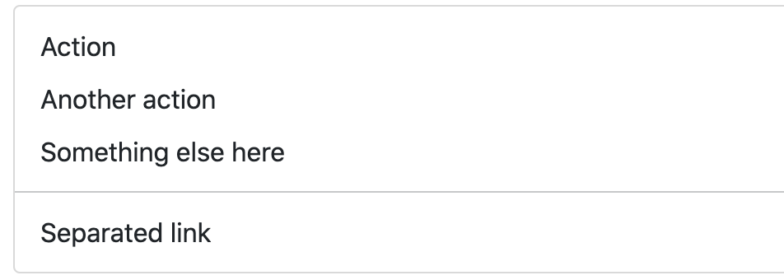
Dividers
<ul class="dropdown-menu">
<li><a class="dropdown-item" href="#">Action</a></li>
<li><a class="dropdown-item" href="#">Another action</a></li>
<li><a class="dropdown-item" href="#">Something else here</a></li>
<li><hr class="dropdown-divider"></li>
<li><a class="dropdown-item" href="#">Separated link</a></li>
</ul>

Slide 29
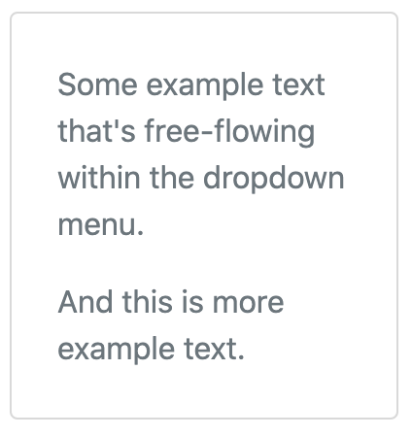
Text
<div class="dropdown-menu p-4 text-muted" style="max-width: 200px;">
<p>
Some example text that's free-flowing within the dropdown menu.
</p>
<p class="mb-0">
And this is more example text.
</p>
</div>

Slide 30
Forms
<div class="dropdown-menu">
<form class="px-4 py-3">
<div class="mb-3">
<label for="exampleDropdownFormEmail1" class="form-label">Email address</label>
<input type="email" class="form-control" id="exampleDropdownFormEmail1" placeholder="email@example.com">
</div>
<div class="mb-3">
<label for="exampleDropdownFormPassword1" class="form-label">Password</label>
<input type="password" class="form-control" id="exampleDropdownFormPassword1" placeholder="Password">
</div>

Slide 31
Forms
<div class="mb-3">
<div class="form-check">
<input type="checkbox" class="form-check-input" id="dropdownCheck">
<label class="form-check-label" for="dropdownCheck">
Remember me
</label>
</div>
</div>
<button type="submit" class="btn btn-primary">Sign in</button>
</form>
<div class="dropdown-divider"></div>
<a class="dropdown-item" href="#">New around here? Sign up</a>
<a class="dropdown-item" href="#">Forgot password?</a>
</div>

Slide 32
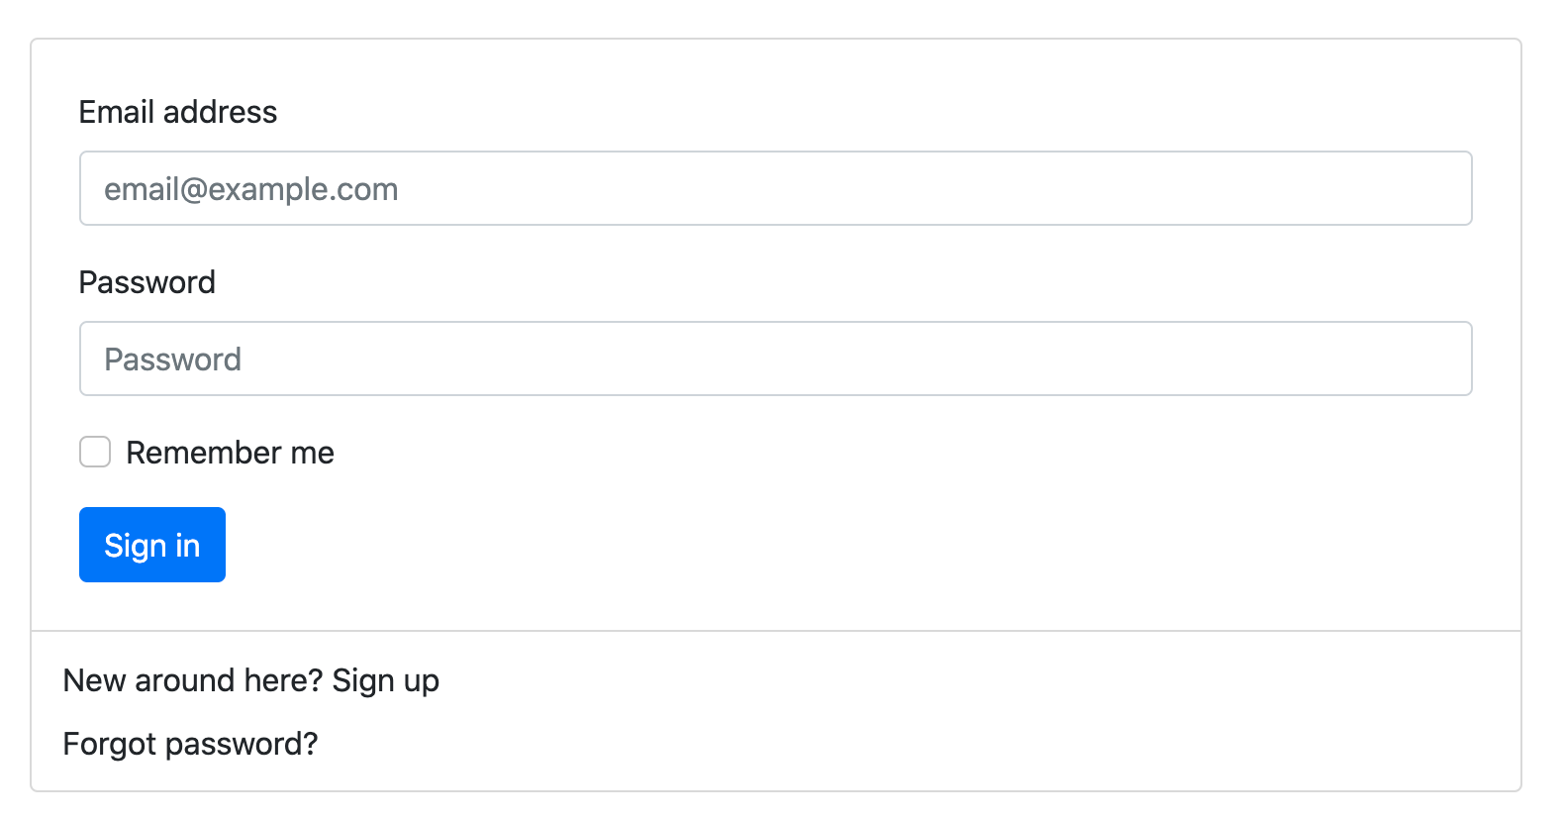
Forms

Slide 33
Form Example 2
<form class="dropdown-menu p-4">
<div class="mb-3">
<label for="exampleDropdownFormEmail2" class="form-label">Email address</label>
<input type="email" class="form-control" id="exampleDropdownFormEmail2" placeholder="email@example.com">
</div>
<div class="mb-3">
<label for="exampleDropdownFormPassword2" class="form-label">Password</label>
<input type="password" class="form-control" id="exampleDropdownFormPassword2" placeholder="Password">
</div>

Slide 34
Form Example 2
<div class="mb-3">
<div class="form-check">
<input type="checkbox" class="form-check-input" id="dropdownCheck2">
<label class="form-check-label" for="dropdownCheck2">
Remember me
</label>
</div>
</div>
<button type="submit" class="btn btn-primary">Sign in</button>
</form>

Slide 35
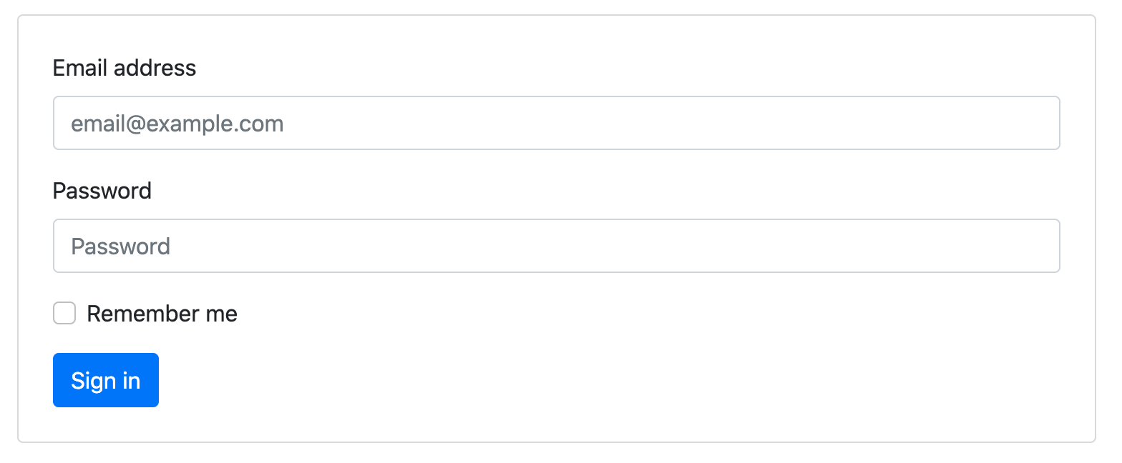
Form Example 2

Slide 36
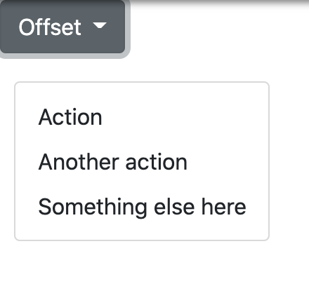
Dropdown options
Use data-bs-offset or data-bs-reference to change the location of the dropdown.
<div class="dropdown me-1">
<button type="button" class="btn btn-secondary dropdown-toggle" id="dropdownMenuOffset" data-bs-toggle="dropdown" aria-expanded="false" data-bs-offset="10,20">
Offset
</button>
<ul class="dropdown-menu" aria-labelledby="dropdownMenuOffset">
<li><a class="dropdown-item" href="#">Action</a></li>
<li><a class="dropdown-item" href="#">Another action</a></li>
<li><a class="dropdown-item" href="#">Something else here</a></li>
</ul>
</div>

Slide 37
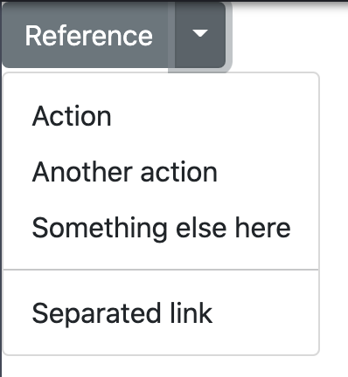
Dropdown options
<div class="btn-group">
<button type="button" class="btn btn-secondary">Reference</button>
<button type="button" class="btn btn-secondary dropdown-toggle dropdown-toggle-split" id="dropdownMenuReference" data-bs-toggle="dropdown" aria-expanded="false" data-bs-reference="parent">
<span class="visually-hidden">Toggle Dropdown</span>
</button>
<ul class="dropdown-menu" aria-labelledby="dropdownMenuReference">
<li><a class="dropdown-item" href="#">Action</a></li>
<li><a class="dropdown-item" href="#">Another action</a></li>
<li><a class="dropdown-item" href="#">Something else here</a></li>
<li><hr class="dropdown-divider"></li>
<li><a class="dropdown-item" href="#">Separated link</a></li>
</ul>
</div>

Slide 38
Auto close behavior
By default, the dropdown menu is closed when clicking inside or outside the dropdown menu. You can use the autoClose option to change this behavior of the dropdown.
Default button:
<div class="btn-group">
<button class="btn btn-secondary dropdown-toggle" type="button" id="defaultDropdown" data-bs-toggle="dropdown" data-bs-auto-close="true" aria-expanded="false">
Default dropdown
</button>
<ul class="dropdown-menu" aria-labelledby="defaultDropdown">
<li><a class="dropdown-item" href="#">Menu item</a></li>
<li><a class="dropdown-item" href="#">Menu item</a></li>
<li><a class="dropdown-item" href="#">Menu item</a></li>
</ul>
</div>

Slide 39
Auto close behavior
Clickable outside
<div class="btn-group">
<button class="btn btn-secondary dropdown-toggle" type="button" id="dropdownMenuClickableOutside" data-bs-toggle="dropdown" data-bs-auto-close="inside" aria-expanded="false">
Clickable outside
</button>
<ul class="dropdown-menu" aria-labelledby="dropdownMenuClickableOutside">
<li><a class="dropdown-item" href="#">Menu item</a></li>
<li><a class="dropdown-item" href="#">Menu item</a></li>
<li><a class="dropdown-item" href="#">Menu item</a></li>
</ul>
</div>

Slide 40
Auto close behavior
Clickable inside
<div class="btn-group">
<button class="btn btn-secondary dropdown-toggle" type="button" id="dropdownMenuClickableInside" data-bs-toggle="dropdown" data-bs-auto-close="outside" aria-expanded="false">
Clickable inside
</button>
<ul class="dropdown-menu" aria-labelledby="dropdownMenuClickableInside">
<li><a class="dropdown-item" href="#">Menu item</a></li>
<li><a class="dropdown-item" href="#">Menu item</a></li>
<li><a class="dropdown-item" href="#">Menu item</a></li>
</ul>
</div>

Slide 41
Auto close behavior
Manual close
<div class="btn-group">
<button class="btn btn-secondary dropdown-toggle" type="button" id="dropdownMenuClickable" data-bs-toggle="dropdown" data-bs-auto-close="false" aria-expanded="false">
Manual close
</button>
<ul class="dropdown-menu" aria-labelledby="dropdownMenuClickable">
<li><a class="dropdown-item" href="#">Menu item</a></li>
<li><a class="dropdown-item" href="#">Menu item</a></li>
<li><a class="dropdown-item" href="#">Menu item</a></li>
</ul>
</div>

